Slide 1
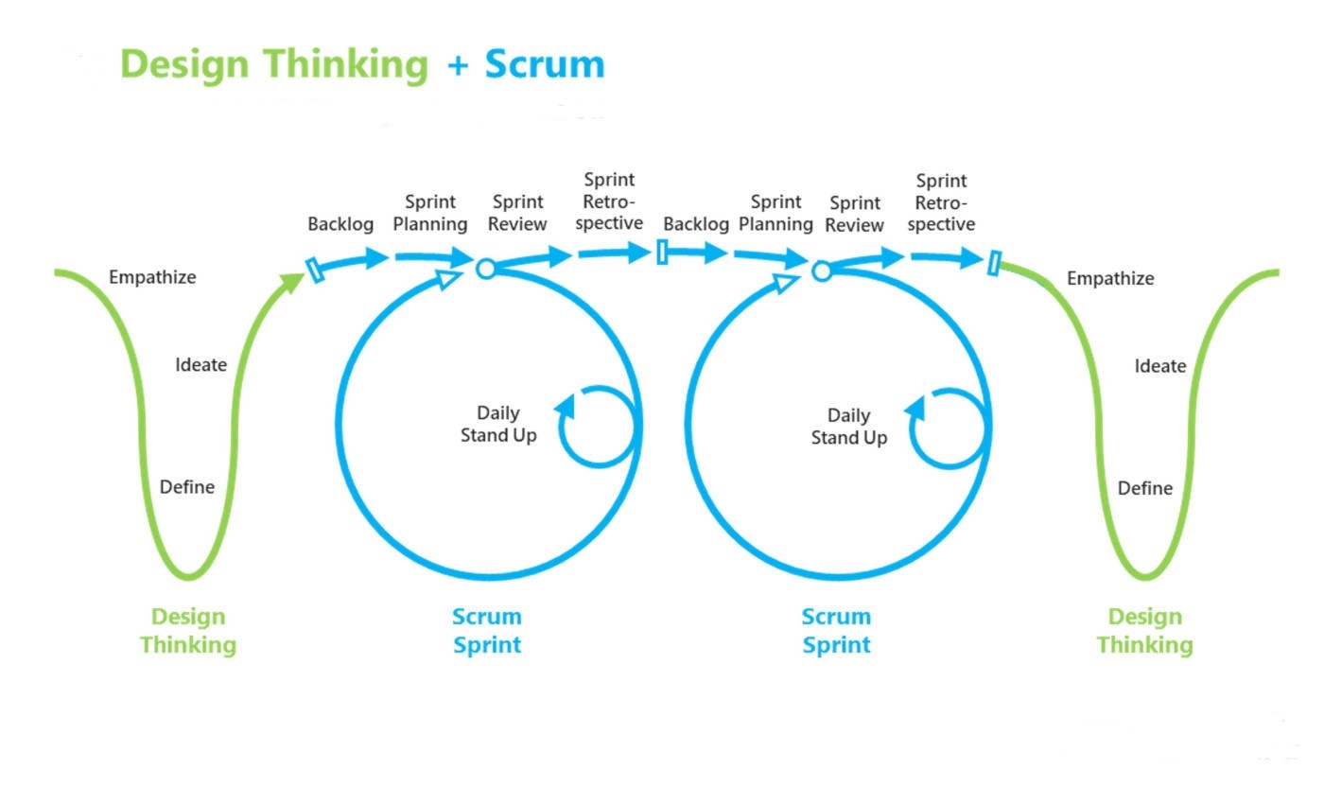


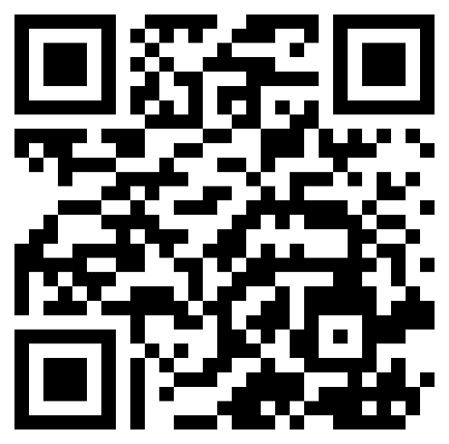
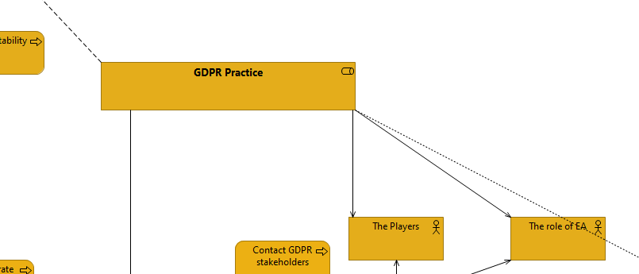

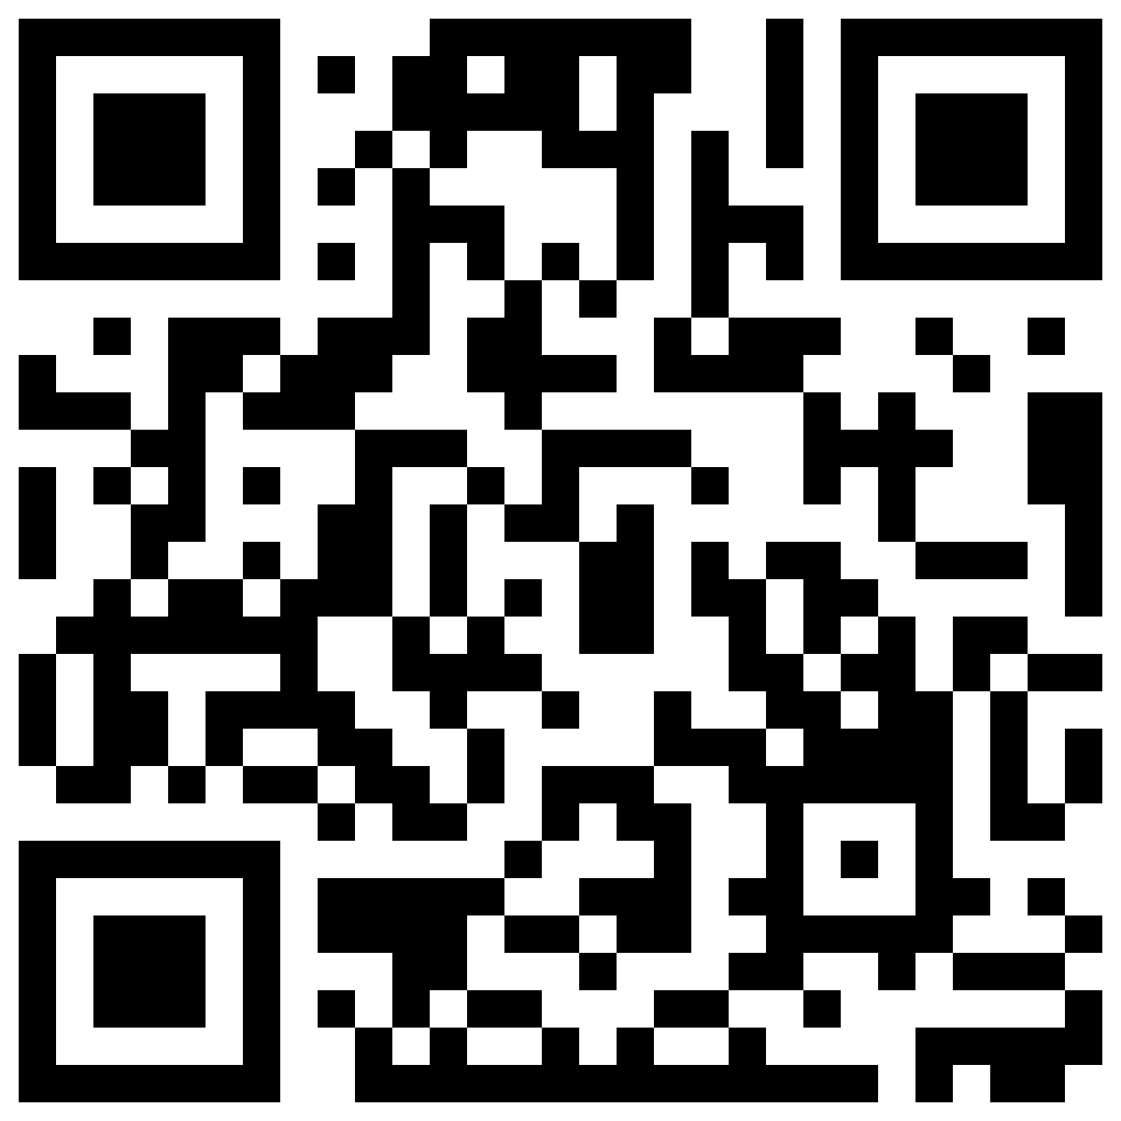


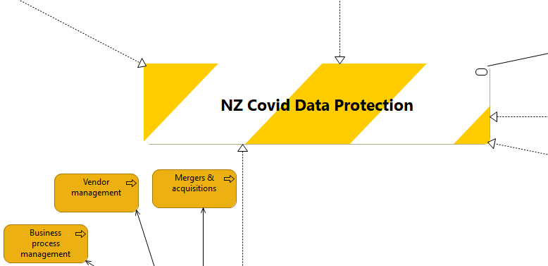

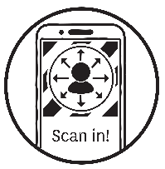



Methodology
NZ COVID DATA PROTECTION MODEL
For Ara Institute of Canterbury Ltd.
Introduction
Deliverables
The NZ covid data protection model is the platform that brings solutions for businesses on data compliance in the context of NZ covid tracer app and developed for the Ara city campus.
This project is the new project I started from the ground, the model going to give solutions about how to businesses owners can handle personal data.
The model developed in one-week increments, using scrum for individual practices, the model was built locally first and sent to the industry supervisor for feedback, then moved through different businesses scenarios before reaching the final product.
Figure 1
Design thinking & Scrum
I developed a model for the Ara city campus, in the model there are multiple solutions for different businesses. Through this model, industries can get knowledge on how to protect personal data and what is the right thing for them regarding their businesses.
The following screenshots are the result of the model. There is one image where it shows the whole solution of the New Zealand data protection model. And in the centre, there is one picture which shows one of the solution from my model.
Julian Siddiqui
Bachelor of ICT
Ara Institute of Canterbury Ltd.
2022 Semester 1
uzairuddin95@hotmail.com
Objective
The goal is to understand and make a model of an Enterprise Architecture (EA) solution and perform tests to identify the limitations and strengths of such solutions.
Also, it is important to read given white papers by industry supervisor. it is critical to provide feedback to improve the quality of the model. Moreover, the white papers are necessary to read to make the model successfully.
Learning Outcomes
uzairuddin95@hotmail.com
List and explain the key elements of software architecture.
Identify a variety of architectural styles and combine them in a single model.
Develop skills on the ArchiMate software.
Describe how software architecture aids different stages of the software lifecycle.
(Yoshida, 2018)
Industry Supervisor:
Amit Sarkar
GDPR Solution
Academic Supervisor:
Robert Oliver
Course Convenor:
Dr David Weir
Process
References
The client was interviewed, requirements gathered and analyzed.
Designs were created and refined.
Read Whitepapers.
Familiarize with the ArchiMate software.
Make user-stories on Excel.
Start making models on the ArchiMate.
Yoshida, T. (2018, Sep 19). Try Design Thinking + Scrum. Retrieved from coachtakeshi.medium.com: https://coachtakeshi.medium.com/design-thinking-plus-scrum-d671a1a8e67a
Tools
Final Model
SCAN ME
ArchiMate
OneDrive
Impact
The New Zealand covid data protection model– is a time saver for businesses who need to find ways how to protect the personal data, by providing better ways of collecting and handle the data.
NZ Covid Tracer
Outlook
Microsoft 365
LeanIX

